Slide 1


The story of your OOP
Assignment
Dr Bryan Duggan
DIT School of Computing
bryan.duggan@dit.ie
@ditcomputing
http://facebook.com/ditschoolofcomputing

Slide 2
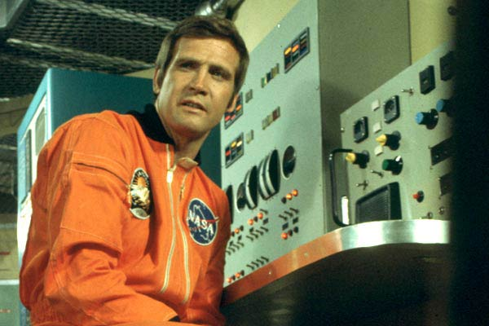
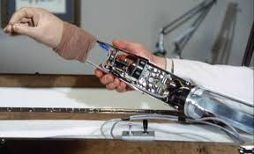
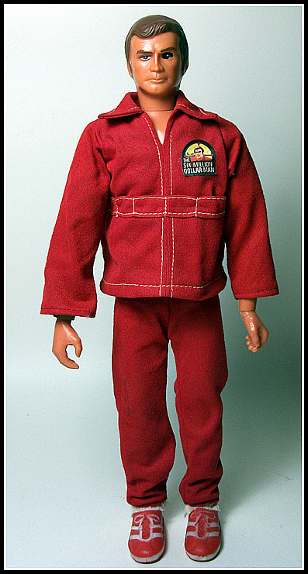
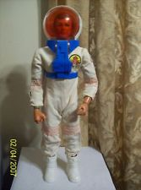
http://www.youtube.com/watch?v=i5zn-mF2-_8

Slide 3
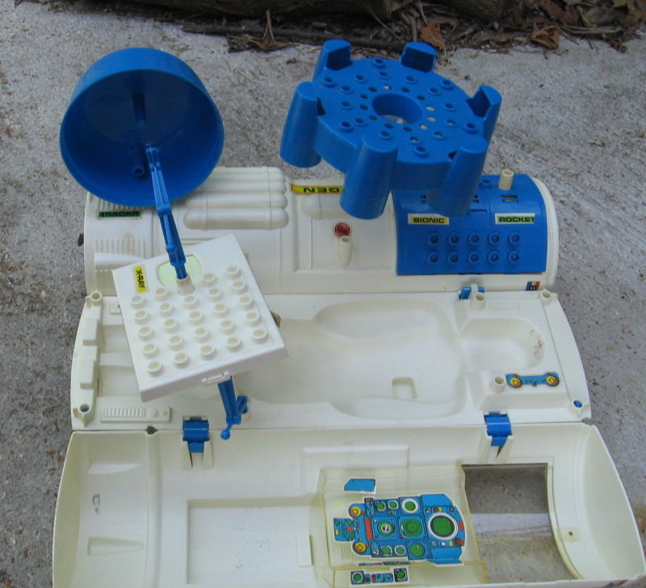
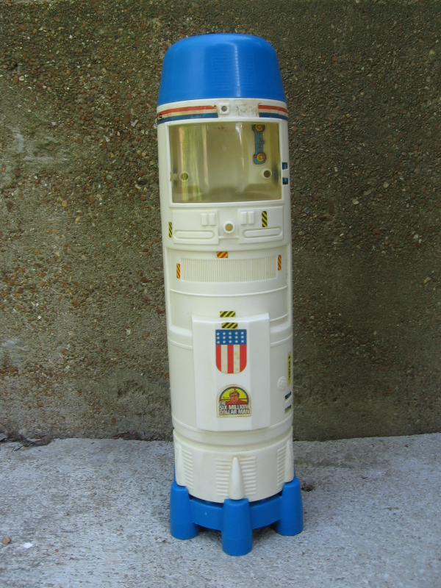

Slide 4

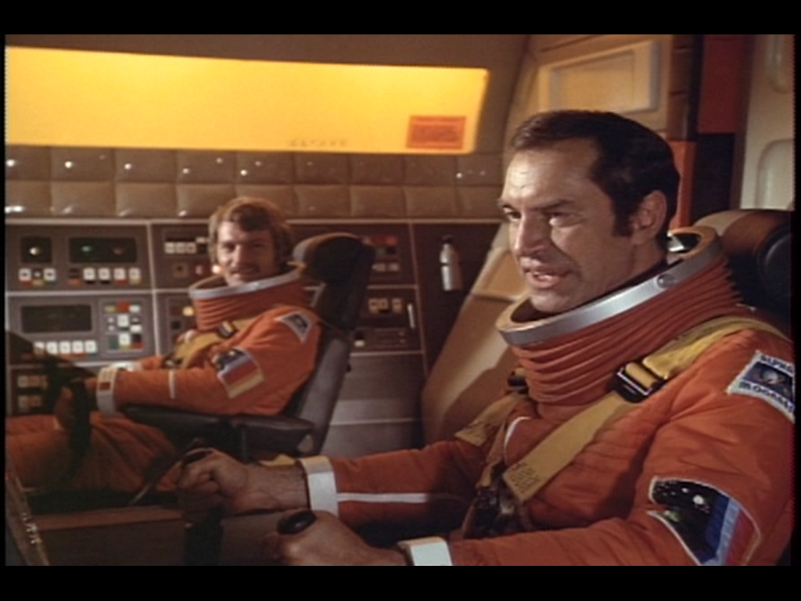
http://www.youtube.com/watch?v=6lbhsqtNvw4

Slide 5
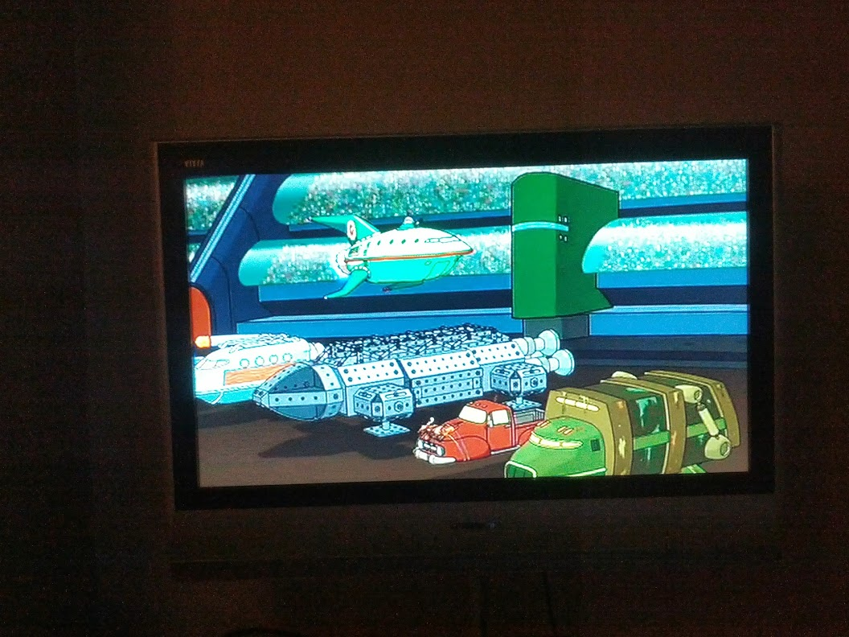

Slide 6
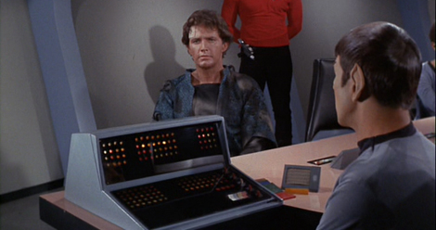

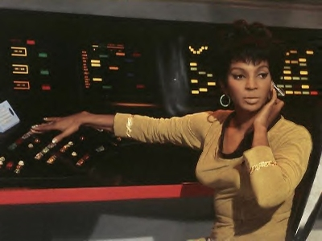
http://www.youtube.com/watch?v=fJfkYjrbPS4

Slide 7
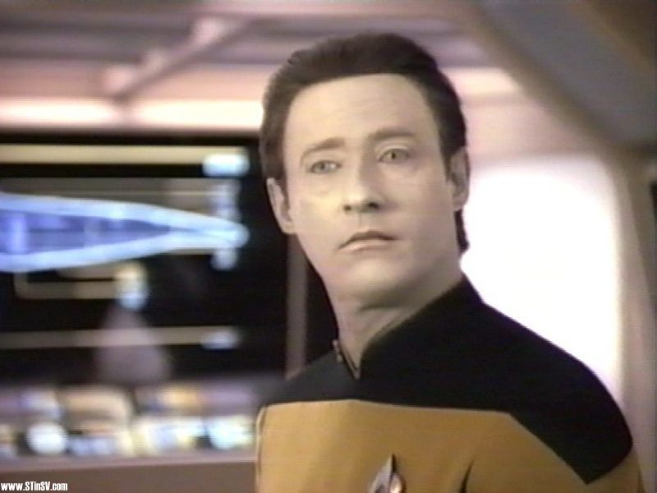
http://www.youtube.com/watch?v=2ZUNLV7e3vU

Slide 8
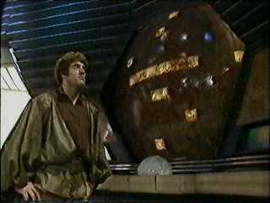
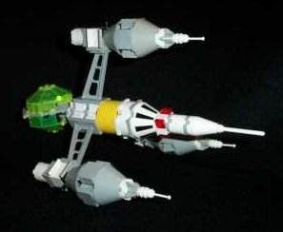
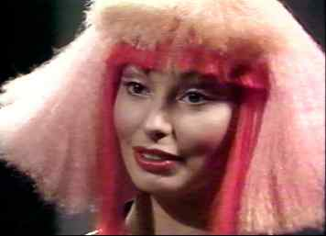
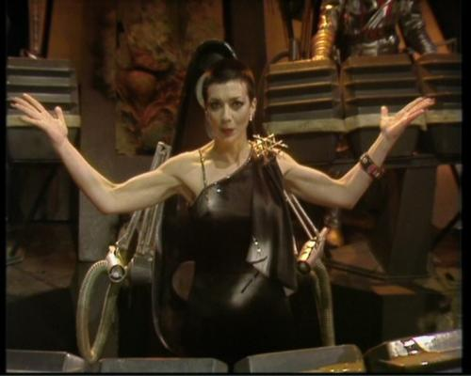
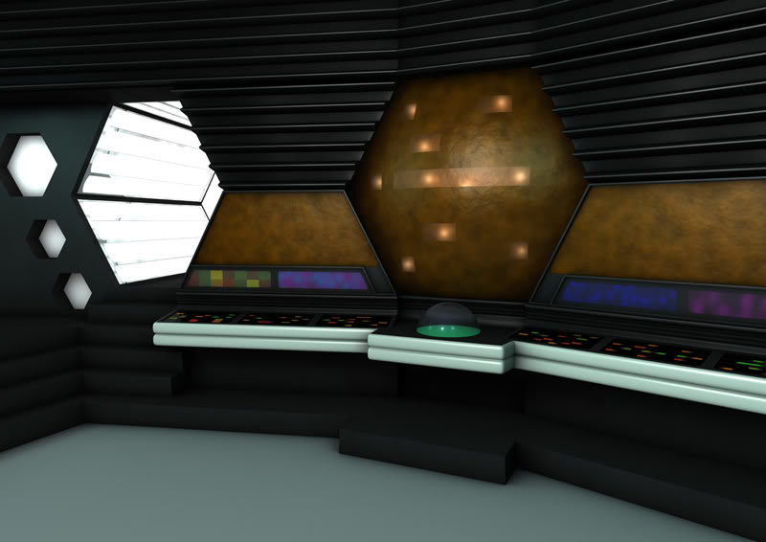

Slide 9

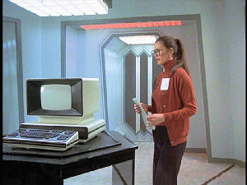
http://www.youtube.com/watch?v=AFVXW9d78T8x

Slide 10
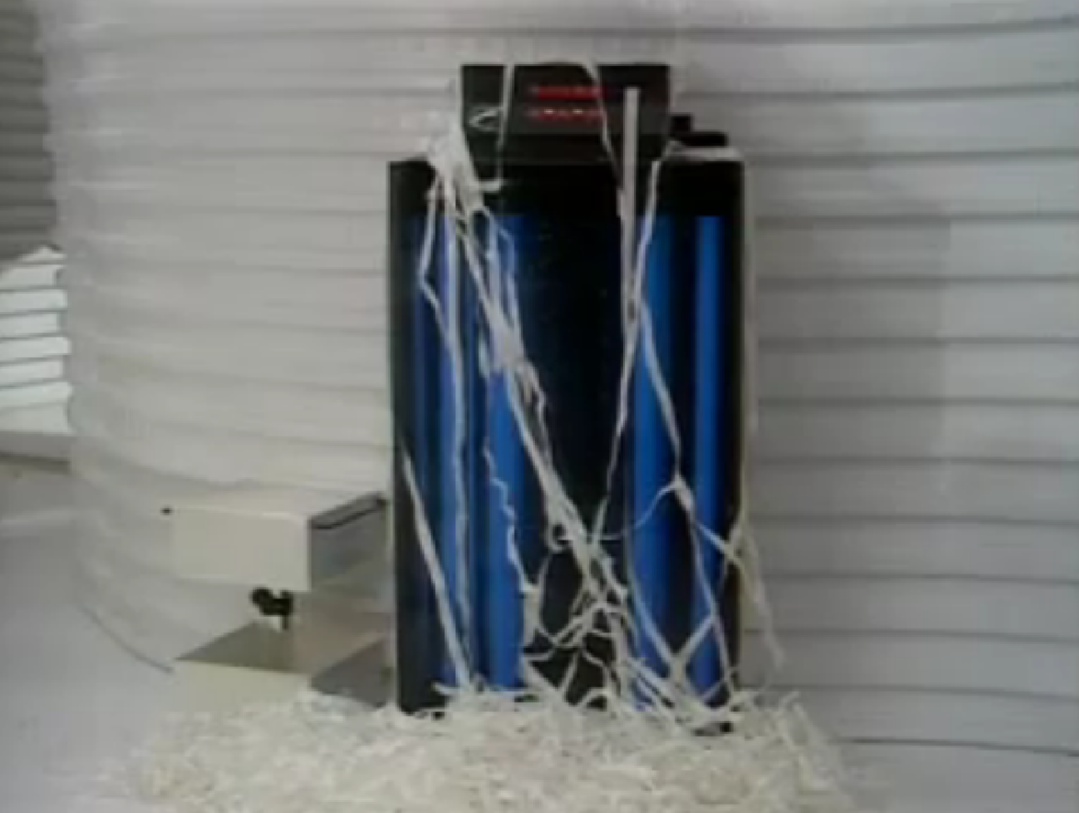
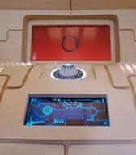

Slide 11

http://www.youtube.com/watch?v=uLwreD9NL7c

Slide 12
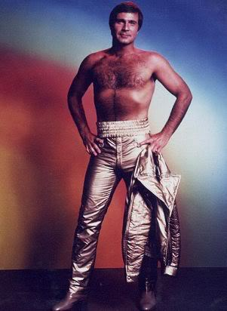


Slide 13

http://www.youtube.com/watch?v=yptoaCKZ0Tw

Slide 14
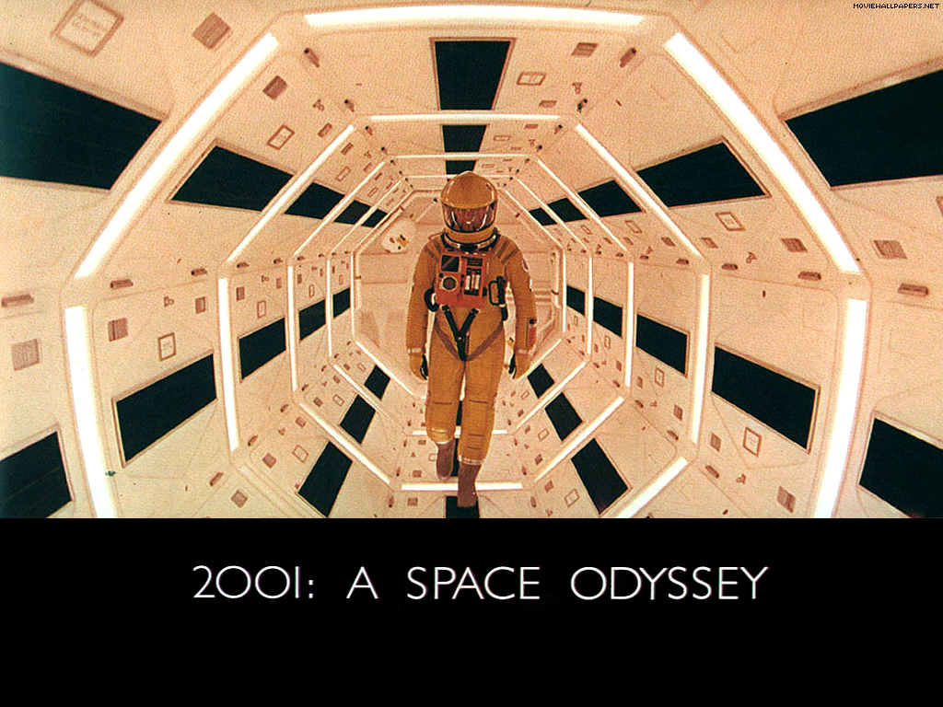

Slide 15
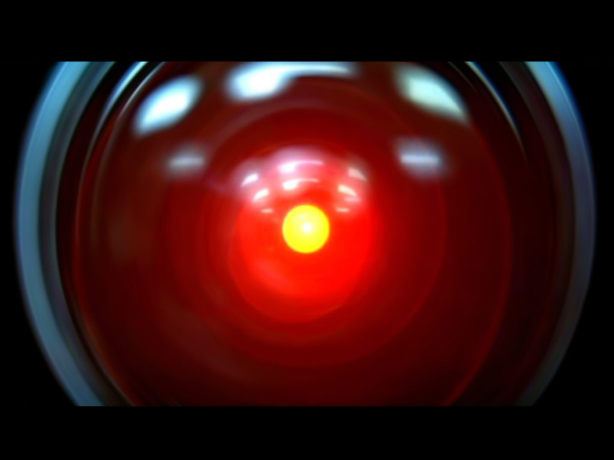
http://www.youtube.com/watch?v=UqOOZux5sPE
http://www.youtube.com/watch?v=HwBmPiOmEGQ

Slide 16

The Black Hole
http://www.youtube.com/watch?v=qzUJJKDa558
http://www.youtube.com/watch?v=n5pOiyD4h6E

Slide 17
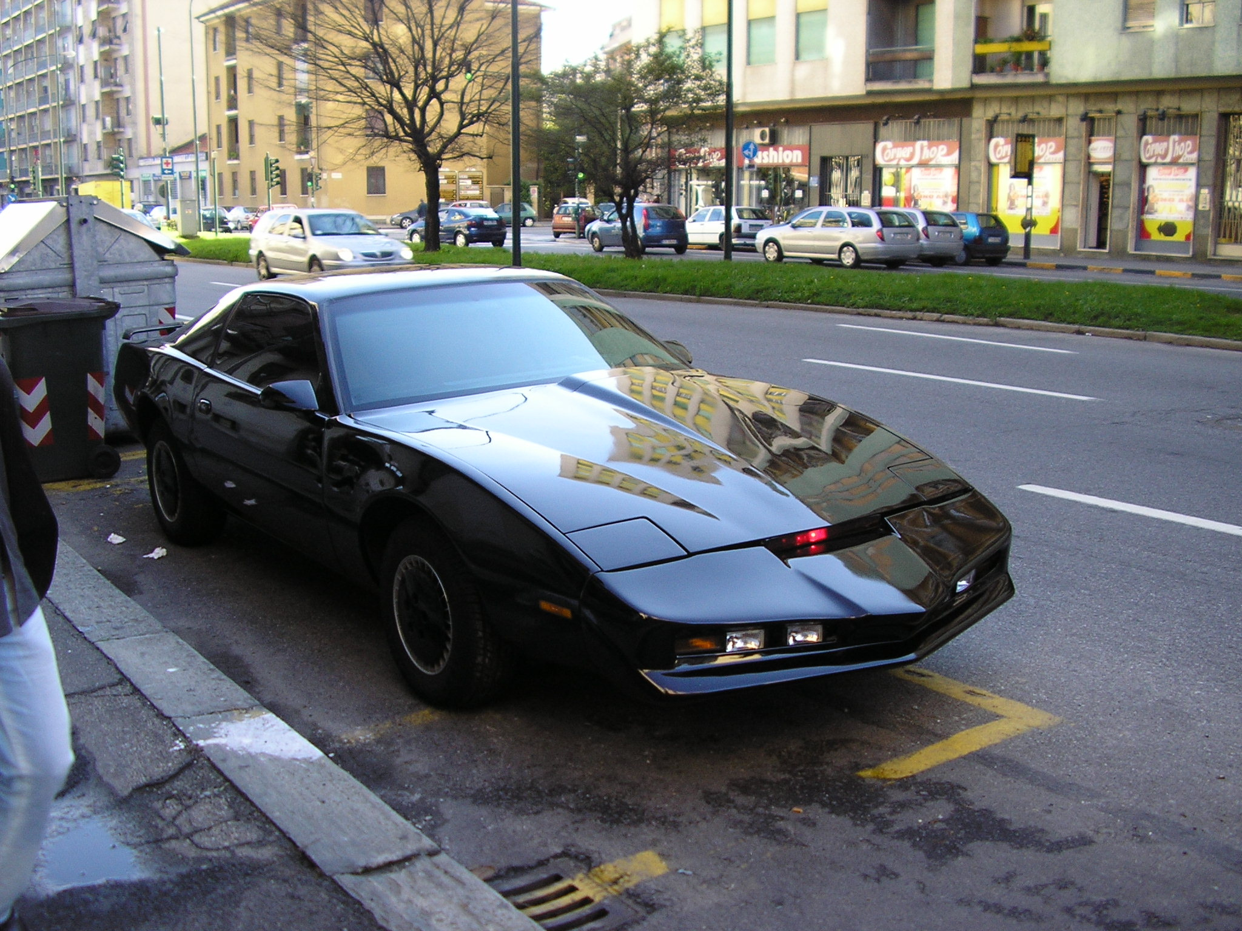

Slide 18

http://www.youtube.com/watch?v=Mo8Qls0HnWo
http://www.youtube.com/watch?v=VKCiJhA7qVo
http://www.youtube.com/watch?v=dCY1pmBxg90

Slide 19
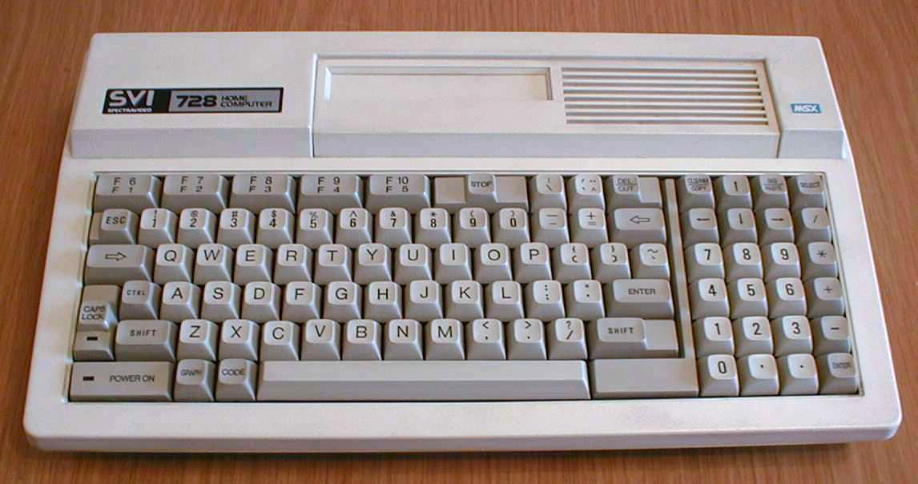

Slide 20
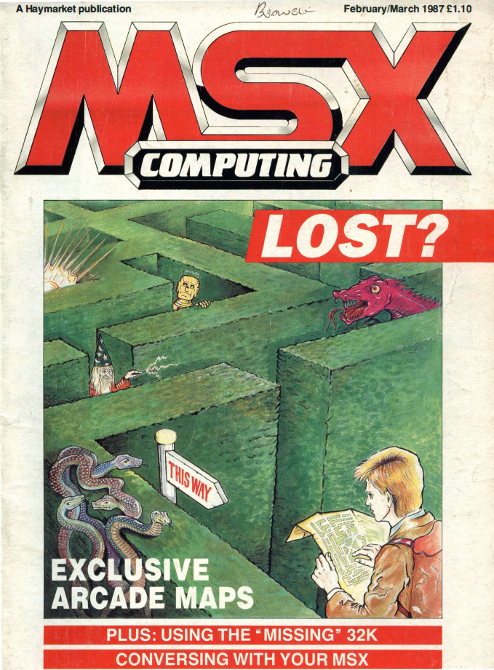

Slide 21
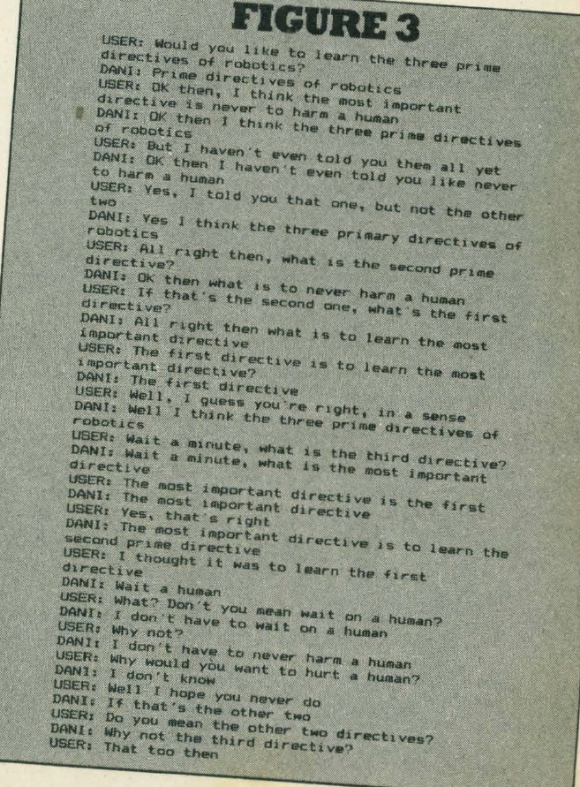

Slide 22

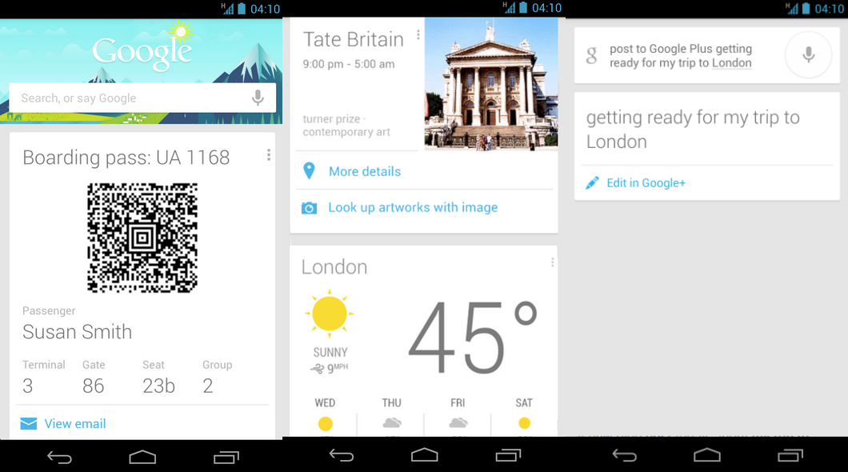

Slide 23
Conversational agents
http://www.youtube.com/watch?v=WnzlbyTZsQY
http://www.semaine-project.eu/
http://robotic.media.mit.edu/projects/robots/leonardo/socialcog/files/page92-movie.mov
http://www.youtube.com/watch?v=UIWWLg4wLEY
http://www.youtube.com/watch?v=IhVu2hxm07E
http://www.youtube.com/watch?v=kThr6CMLrvg

Slide 24
http://www.youtube.com/watch?v=1-0eZytv6Qk
http://robotic.media.mit.edu/projects/robots/leonardo/socialcog/socialcog.html

